Slide 1
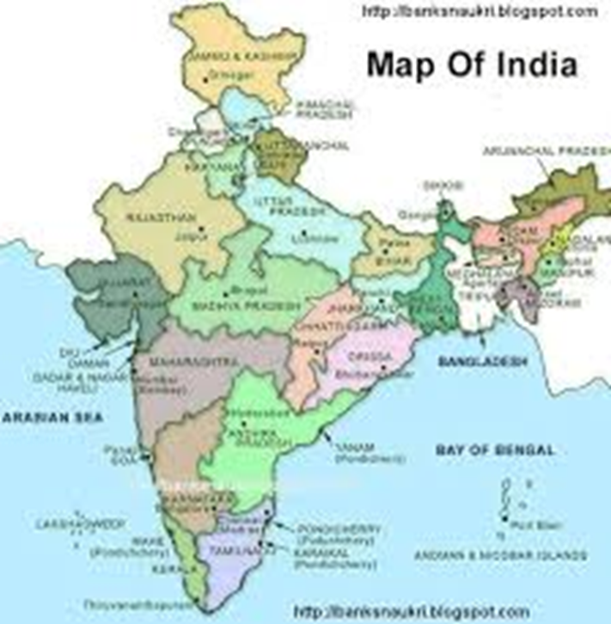
Reanalyzing South-Central Tibeto-Burman’s Internal Structure:
Evidence from Lamkang
Mary Burke | University of North Texas | Mary.Burke@unt.edu
Goal
Previous SCTB Subgroupings
Findings
Find which subgroup of South-Central Tibeto-Burman (SCTB) Lamkang belongs to using the comparative method
Center-Periphery (VanBik, 2009)
homorganic assimilation
retention of PSCTB *y-
merger of PTB *s-/*t- > Lamkang d-
About the Lamkang Project
NSF-funded project to create a lexical database of Lamkang (#1160640)
Development of orthography in progress
Word lists based on published materials and discussions with speakers
Conclusions
Geography-Based (Linguistic Survey of India)
Lamkang belongs to the Central Chin subgroup of SCTB
Lamkang forms a separate branch
About Lamkang
Tibeto-Burman
South-Central Tibeto-Burman
under 10,000 speakers
SOV
agglutinative
Sound Correspondences
Clusters: homorganic assimilation
Sonorants: retention
Obstruents: merger
PTB | *pl- | *p^{w}- | *pr- | *bl- | *br- | *dz- | *gl- | *kl- | *kr-
PSCTB | -- | *w- | -- | -- | *r- | *ɗ- | *hl- | *khl- | *k(h)r-
PCC | -- | -- | -- | -- | -- | -- | -- | *thl- | *t(h)r-
LMK | -- | v- | -- | -- | pr- | ʈ- | l- | t(h)l- | ʈ(h)-
Future Research
Hypothesis: Lamkang belongs to the Central Chin subgroup of SCTB
investigate Lamkang final consonants
re-assess VanBik’s SCTB subgrouping
access data from other SCTB languages
PTB | *m- | *w- | *n- | *l- | *r- | *y- | *ŋ-
PSCTB | *m- | *w- | *n- | *l- | *r- | *y- | *ŋ-
LMK | m- | v- | n- | l- | r- | y- | ŋ-
Evidence for SCTB
PTB *s-/*sy- > PSCTB *th-
Verb stem alternation
Selected Resources
VanBik, K. (2009). Proto-Kuki-Chin: a reconstructed ancestor of the Kuki-Chin languages. Berkeley, CA: Sino-Tibetan Etymological Dictionary and Thesaurus Project, Dept. of Linguistics research unit in Univ. of California, Berkeley.
Peterson, D. A. (2017). On Kuki-Chin Subgrouping. In Sociohistorical Linguistics in Southeast Asia (pp. 189-209). BRILL.
Evidence for Central Chin
Homorganic assimilation
PSCTB *khl- > PCC *thl-
PSCTB *k(h)r- > PCC *t(h)r-
PSCTB *y- > PCC *z-
PTB | *p- | *b- | *t- | *d- | *s- | *z- | *k- | *g- | *h-
PSCTB | *p- | *ɓ- | *t- | -- | *th- | *θ- | *kh- | *k- | *h-
LMK | p- | b- | d- | -- | d- | ts- | kh- | k- | h-

